Slide 1


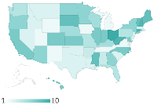

Key finding, statement or
an intriguing research question
Name Surname
Affiliation
Email
The Problem
RESULTS
Conclusions
Think of someone who is not from your field. Now shortly explain him why you are doing the research…
Key conclusion about the graph
Visual layout will help you to present the research
Only include results that support the key statement on top
White space focuses attention to the important bits.
Point the viewers to something specific in the figures. What are they looking at?
Objective
Further info
Bullet points can be useful
They are easier to read than blocks of text
To draw attention to something, make it stand out from the rest of the chart
Paper Title
Co-Author No.1, University
Another author, Another university
In one short sentence explain what did you want to accomplish.
A related paper of yours, year
Another paper, year
Your web address, QR code, and other info
Methods
Only basic info. The paper holds all the details about methods.
Acknowledgments
Reference to the funder
Conflict of interests statement
Logos of partners
Notes:
Download this template at http://peerrecognized.com/poster

Slide 2
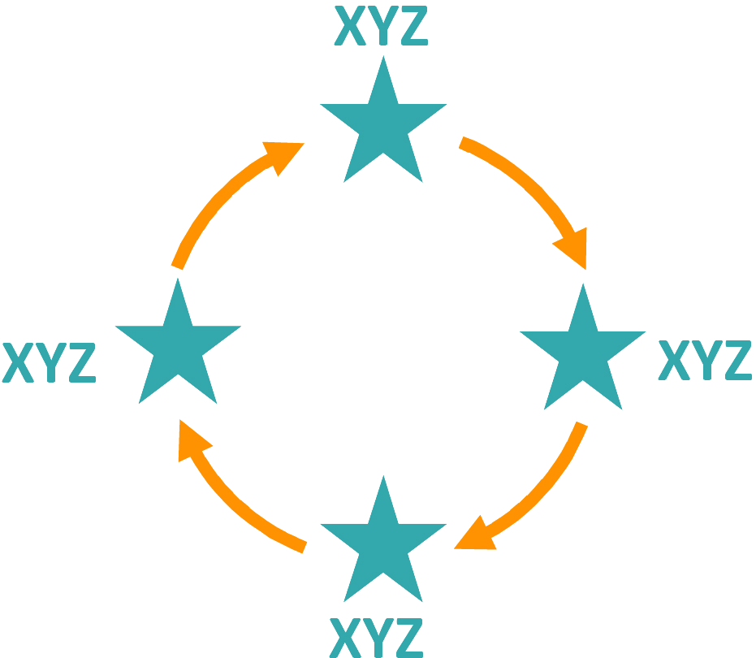
Key finding, statement or an intriguing research question
Name Surname
Affiliation
Email
The Problem
Results
Conclusions
Think of someone who is not from your field. Now shortly explain him why you are doing the research…
1
Visual layout will help you to present the research
Only include results that support the key statement on top
White space focuses attention to the important bits.
2
Use numbers or familiar shapes to show steps or different applications of your research
Point the viewers to something specific in the figures. What are they looking at?
Objective
Further info
Paper Title
Co-Author No.1, University
Another author, Another university
In one short sentence explain what did you want to accomplish.
A related paper of yours, year
Another paper, year
Your web address, QR code , and other info
Methods
4
3
Only basic info. The paper holds all the details about methods.
Bullet points can be useful
They are easier to read than blocks of text
To draw attention to something, make it stand out from the rest of the text
Acknowledgments
Reference to the funder
Conflict of interests statement
Logos of partners
Notes:
Download this template at http://peerrecognized.com/poster

Slide 3
Key finding, statement or an intriguing research question
Name Surname
Affiliation
Email
The Problem
Results
Conclusions
Think of someone who is not from your field. Now shortly explain him why you are doing the research…
Visual layout will help you to present the research
Only include results that support the key statement on top
White space focuses attention to the important bits.
Point the viewers to something specific in the figures. What are they looking at?
To draw attention to something, make it stand out from the rest of the chart
Objective
Further info
Paper Title
Co-Author No.1, University
Another author, Another university
In one short sentence explain what did you want to accomplish.
A related paper of yours, year
Another paper, year
Your web address, QR code , and other info
Methods
Only basic info. The paper holds all the details about methods.
Use familiar shapes
how a certain process
to show
works.
Acknowledgments
Reference to the funder
Conflict of interests statement
Logos of partners
Notes:
Download this template at http://peerrecognized.com/poster

Slide 4
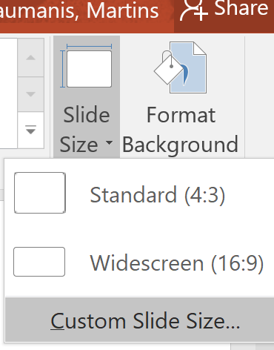
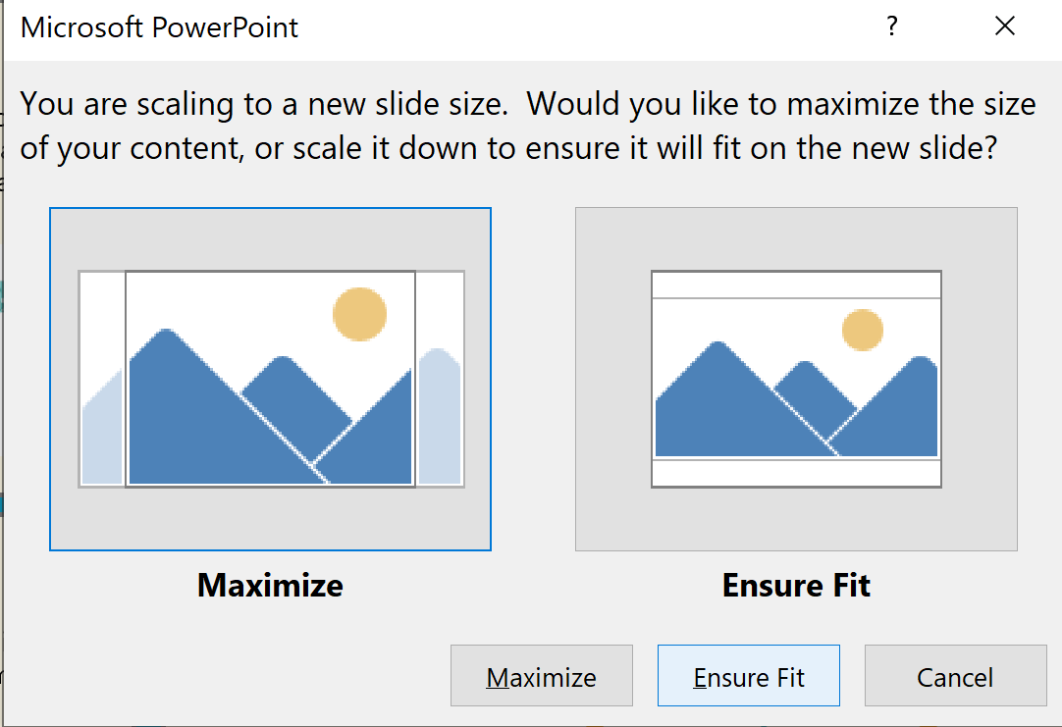
To change the poster size:
1) Select the Design tab of the toolbar ribbon.
2) Select Slide Size icon near the far right end of the toolbar.
3) Click on Custom Slide Size and enter the desired dimensions.
4) Select Ensure Fit when prompted

