Slide 1


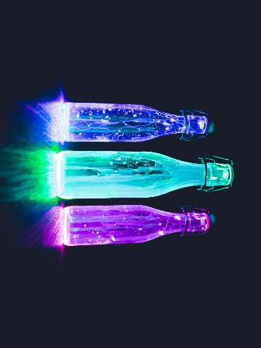

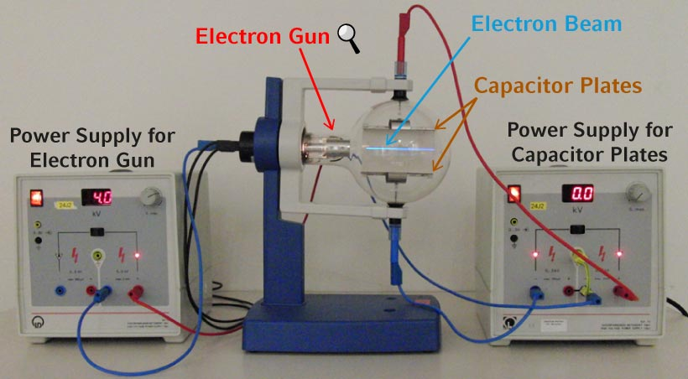
Title By: Xxx and xxx* College of STEM Symposium, March 25, 2025 Clayton State University, Morrow, GA *Presenter. presenteremail@clayton.edu
Abstract: this is optional Introduction
Use text font size between 24 and 28 for optimal viewing . The poster size is 48” by 36” (4’ by 3’), make sure that you have this setting when converting to high quality (print quality) pdf. 300 dpi or better is preferred.
Some text here about Table 1 perhaps.
Experimental Results
Text here This change are hindered by technical problems. The further details are available in [5]
Table 1: Table caption should be ON TOP. NO SCREENSHOTS for tables!
test | headers
data
Figure 1a: a sample of organic liquid under the UV light. Small images can be placed around text.
Figure 1b: a sample of organic plastic. Can have captions like this.
Experimental Setup
The experimental setup was built in the something shown in Figure 2. Refer to all figures and tables in text. Figure 2: Overview of the experimental setup. This is the most preferred caption style. Large images should be placed like this with no text around them. Can include attribution here as [1] instead.
From Figure 8 we
Conclusion
The measurements of the thing were success with 100% failure rate ☺ Further plans Any plans?
References
[1] Use IEEE style references. Reference for that Figure 2
To some other text
Remember to give attribution as needed. This Photo by Unknown Author is licensed under CC BY-NC-ND
Experimental Results
Some description and reference to Figure 3
Figure 3: R580 PMT total response. Format Excel plots after pasting. NO SCREENSHOTS for plots!

